Slide 1
Lecture 8
Analysis and Evaluation of
Software Architectural Designs
Prof. Hong Zhu
Dept. of Computing and Communication Technologies
Notes:
Evaluate one design each

Slide 2
Today’s Lecture
Approaches to evaluating architectural designs
Scenario-based
Model-based
Principles of scenario-based evaluation of architectural designs
How to specify quality requirements in scenarios
How to evaluate design against quality requirements specified in scenarios
The SAAM method
Process
Case study
Notes:
Scenario based is old and well established
Model is new.
More emphasis on scenario
Use SAAM on the coursework
Only need to do modifiability quality

Slide 3
Evaluation of architectural designs (I)
Scenario-based approaches
Abstract and amorphous quality attributes are represented with more tangible scenarios
The interaction between a stakeholder and the system in the scenario is elaborated in the evaluation
The outcomes and the quality related properties of the interactions are collected to demonstrate the quality of the design
Suitable for evaluating the quality of a design against a set of known criteria
Notes:
Stake holders include future programmers for debugging.

Slide 4
Evaluation of architectural designs (II)
Model-based approaches
A quality model of the system is derived from architectural design
Quality related features are deduced from the model
Capable of discovering unknown quality problems prior to the evaluation

Slide 5
Scenarios
Revision:
Scenarios are used in requirements analysis;
The notion is now extended and more general.
Generally speaking, a scenario is a set of situations of common characteristics that might reasonably occur in the interactions between stakeholders and a system.
The set of situations must satisfy three conditions:
Participating Stakeholders:
all the situations in the set involve a specific subset of stakeholders in the interactions with the systems.
Operation condition:
all the situations in the set occur under a certain specific operational condition and/or in a certain state of the system.
Interaction purpose:
all the situations in the set occur when the stakeholders interact with the systems for the same purpose.
Notes:
Must include the three components for a scenario

Slide 6
Example 1: Generic Scenario vs Concrete scenario
Stakeholder
Purpose of interaction
Scenario 1: An end user wants to change the background colour of the windows of the users’ interface.
Scenario 1a: User John changes the background colour on all windows to blue.
Scenario 1b: User Smith changes the background colour on all windows to black.
Instances of the stakeholder
Instances of interactions
Operation condition is implicit: (a) without change the program code; (b) during the execution of the software.
Notes:
Condition is assumed, we assume the user wont change the code and we assume the scenario takes place during run time. This is an assumed condition and is not explicitly mentioned.

Slide 7
Example 2:
Operation condition: (a) without change the program code; (b) during the execution of the software.
Purpose of the interaction
Stakeholders
Adaptability of user interface
Scenario 1: An end user wants to change the background colour of the windows of the users’ interface.
Scenario 2: A programmer wants to change the background colour of the same software’s windows.
Modifiability of the system
Operation condition: (a) Change the program code; (b) Before the execution of the software.
Notes:
Changing stake holder changes the scenario completely. Operation condition now assumes the stake holder will change the code as the stake holder is the programmer. This assesses the modifiability of the system whereas the previous example assessed adaptability of the interface.

Slide 8
Scenarios for evaluating software modifiability
There are many different scenarios that may require a system to be modified.
Common scenarios that require modifications
Changes of users’ functional requirements
Changes of hardware environment
Changes of software environment
Changes of software components
Correction of errors in the design and implementation of the system
Notes:
The above scenarios are generic and will need to be more specific.

Slide 9
Scenarios in which functional requirements change
Such scenarios are represented the same as in requirements specification of functional requirements
Such changes often fall into two types:
Enhancement of functionality:
To introduce new functions into an existing system
Amendment of functionality:
To change or remove an existing function
Example: to change the way a function is delivered
Example:
The user inputs a text file and the system produces a keyword frequency vector in the form of sequence of keywords and their number of occurrences in the text file. In the keyword frequency vector, small words are removed and synonyms are treated as the same word in the calculation of the frequency that the word occurs in the document.

Slide 10
Ways of delivery of functions
Example: delivering spelling check in email applications
 | Processing as a whole | Incremental processing
Explicit invocation | The interface of the software contains a button or menu item for spelling check. The spelling of the whole email text in the editing window is checked when the user clicks the button or selects the menu item. All misspelled words are marked somehow, for example, underlined, after the spelling check is finished. The user can then correct the misspelled words. | The interface of the software contains a button or menu item for spelling check. The spelling of the whole email text in the editing window is checked when the user clicks the button or selects the menu item. The misspelled words in the editing window are displayed to the user one by one, for example in a popup window, possibly together with recommendations for correctly spelled words.
Implicit invocation | The spelling checker is invoked implicitly and it checks the whole text in the editing window. Such invocation is triggered by certain events, such as when the ‘send email’ function is invoked. | The spelling check is invoked implicitly and it processes the spelling check incrementally. For example, it may check each word while the user types a message into the window. In this case, the trigger event of the invocation of the spelling check is type in words.
Notes:
Explicit – asked for
Implicit – not asked for

Slide 11
Scenarios in which hardware environment changes
Caused due to the upgrading of hardware platform to take advantages of new computer and network technology
Required changes are typically to migrate system to a new platform
It is still possible to cause adverse effects.
Examples:
1: The computer that the software system is executing on is upgraded to a more powerful one with larger memory space and high processing speed, but completely compatible with the existing one.
2: The computer that the software system is executing on is changed to a new computer, which is a product from a different manufacturer. The hardware of the new computer is not compatible with the existing one.

Slide 12
Examples: changes in computer network
Potential impacts:
3: A new computer is added into the network as an additional server to improve the system’s performance. The new server is of the same type as the existing ones.
4: A new computer is added into the network as an additional server. It is of different type from the existing one.
5: The computer network is upgraded from 10M Ethernet to 100M Ethernet.
6: The computer network is added with some wireless connections so that notebook computers and handheld computing devices can be connected into the system from the wireless network ports.
New deployment;
Change of configuration;
Load balance issue;
Remain homogeneity.
Portability issue
Become heterogeneous.
Network capability
System performance
Mobilability;
Security issues;
Interface for handheld devices.

Slide 13
Scenarios in which software environment changes
Changes in the systems software and other supporting systems, such as:
operating systems, database management systems, middleware, network and communication packages,
Changes in the external entities that the system interacts with.
Examples:
1: Upgrade operating system from Windows 98 to Windows NT;
2: Change of the operation system from Windows to Linux;
3: Change the middleware of the system from CORBA to DCOM.
4: A web-based application that links to a specific website that provides an online map. The website that provides the online map changes its web address, and/or the way online maps are requested.
5: A shopbot software agent helps the users to compare the prices of books that online bookstores on the web offer for online shopping. An online bookstore that the shopbot links to changes its format of messages in the way that the prices of books are requested.

Slide 14
Scenarios in which a software component is changed
The components used by system often evolve and change, thus require the software to change accordingly.
Components from other developers, such as COTS (component-off-the-shelve), shareware, open source, etc.
In house components
Examples:
1: The representation of data produced by a new version of a third party component is changed.
2: The representation of the data required by a new version of a third party component is changed.
3: The format of messages sent to and received from a new version of a third party component is modified.
4: The interaction protocol to access a new third party component is different from the original third party component. The protocol determines the sequences of messages sent to and received from the component.

Slide 15
Evaluation of modifiability against scenarios
The general process of evaluation
Identify the components and connectors that need to be modified in a scenario or a set of scenarios
Estimate the efforts/cost to perform the modification on each component/connector
Calculate the total amount of effort/cost

Slide 16
Scenarios for evaluating performance
Scenarios are used to specify system operation profiles in normal average usage, worst cases and best cases.
Usage profiles can be specified in terms of the volumes of input/output data, frequency and/or probability that certain type of events occur, etc.
Examples:
1: The website of a newspaper is expected to have about 5000 users browsing its web pages simultaneously at peak hours, which usually occur from 12:00 pm to 2:30 pm every working day.
2: The website of a newspaper is expected to have about 200 new HTML files posted on its website for updating during the peak hours, which usually occurs from 11:30 am to 12:30 am everyday.
3: A software system used to collect and process data in wind tunnel experiments is connected to 100 to 500 pressure sensors. The software will take readings from each sensor every 2ms during the process of a wind tunnel experiment, which usually lasts no more than 10 minutes.
Notes:
Ignore for coursework

Slide 17
4: A room temperature control system is usually connected to 10 to 100 temperature sensors depending on the size and structure of the building. These sensors are grouped into a number of sets according to the rooms they are in. The system reads the temperature readings from each sensor every 2 minutes and calculates each room’s temperature. When the room’s temperature is lower or higher than the room’s set temperature by a certain degree, the air conditioner of the room must be switched to heat or cool or off within 10 seconds.
5: In the room temperature control system described in scenario 4 above, each room has a temperature setting, which can be changed according to the goods stored in the room. On average, a room temperature setting changes once in the period of 3 months. Once a new setting is made, the switch of the air conditioner should be reset immediately after a delay of 20 seconds.
6: The email application software is expected to send and receive text messages of a length up to 5000 characters, but a message may have attachment files of a size up to several megabytes.
7: The word processor is expected to be used to edit and format files of a length about 2,000 words to 20,000 words. However, in extreme cases, the file’s size could reach 5,000,000 words. A file may also contain data from other office applications, such as drawings, charts, and photos, etc.

Slide 18
Evaluation of performance against scenarios
General process
Obtain information about each component/connector’s performance
According to the architectural design, to calculate the information process time/space by the system according to the profile.

Slide 19
Example
Evaluation of Pipe-and-filter design of KFV
Scenario:
On average, a text file to be processed by the Keyword Frequency Vector extraction system consists of N characters.
The average length of the words is about 6 characters.
Among the words, there are about 40% small words that should be removed from the frequency calculation, and
The number of different keywords is only about 1% or less of the total number of words.
The numbers given here are only for illustration purposes!

Slide 20
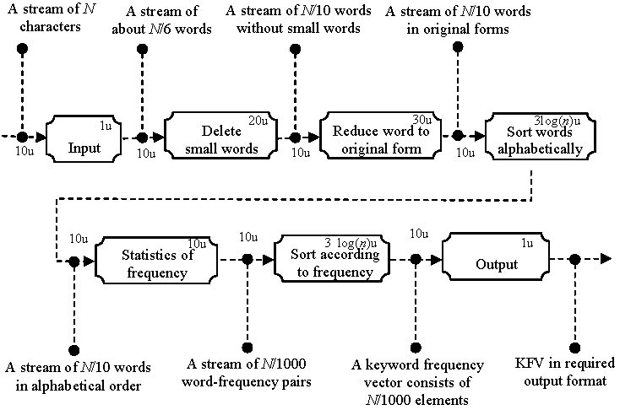

Slide 21
KFV Pipe-and-Filter’s performance
Component | Start time | Time to first output | Output rate | Number of output | Time to finish
Input | 0 | 6 | 6 | N/6 | N
Delete | 16 | 36 | 28 | N/10 | 16 + 20 × N/6
Reduce | 46 | 76 | 30 | N/10 | 76 + 3 × N
Sort Words | 86 | T₁ | – | N/10 | T₁
Statistics | T₁+10 | T₂ | – | N/1000 | T₂
Sort KFVs | T₂+10 | T₃ | – | N/1000 | T₃
Output | T₃+10 | T₃+10+1 | 1 | N/1000 | T₄

Slide 22
Scenarios for evaluating reusability
The best way to specify reusability requirements is to explicitly specify the context in which a software artifact is to be reused. Such contexts can be described as scenarios.
Reuse within a series of product of the same kind;
Reuse across product boundary but within the same application domain thus the products have same subset of functionality.
A scenario should specify what are the same and what are the differences.
Notes:
This relates to the re-use of a software component.

Slide 23
Examples:
1: The software to be developed belongs to the office applications domain, and other products of the same domain are planned to be developed in the future.
2: The software to be developed is a real-time control of rapid moving machinery. At the time of software architectural design of the project, another customer is negotiating with the developer to develop a software system to control a big warehouse’s temperature.
3: A software development company is specialised in developing customer relationship management systems (CRM) automated call centres. Their customers come from various sectors of industry and public services, such as energy providers, satellite and cable TV programme providers, communication providers, banks, mortgage lenders, etc.
4: A software development company is specialised in developing printer drivers for various makes and models of printers to be installed on various computer hardware and software platforms.
A: A number of printer drivers for various makes and models of printers are required to be developed to be installed on a specific computer hardware and software platform.
B: A number of printer drivers are required to be developed for a specific model of printer to be installed on various computer hardware and software platforms.

Slide 24
Software Architecture Analysis Method
The input of an SAAM evaluation
Description of architectural design(s)
The quality requirements specified as a set of scenarios
A scenario is a brief description of a single interaction of a stakeholder with a system.
E.g. ‘change the background colour on all windows’
A scenario actually serves as a representative for an entire class of ‘scenarios’.
‘change the background colour on all windows to blue’
‘change the background colour on all windows to black’
An agreed set of scenarios is used as the benchmark to compare and contrast different candidates
Notes:
Inputs:
Diagram and text description of the design
Lots of simple interactions
Don’t use instances of scenarios, eg, change colour to blue, use generic, eg change colour.
USE SAME SCENARIOS ON EACH DESIGN, COME UP WITH THESE AS A GROUP.

Slide 25
Two Uses of SAAM
To compare two or more candidates to see which one satisfies its quality requirements more fully.
The input:
Two or more architectural designs
To evaluate a single design to point out places where that architecture fails to meet its quality requirements (in some cases to show obvious alternative designs that would work better).
The input:
One architectural design

Slide 26
The Process of SAAM Analysis
Stage 1
Scenario development
Stage 2
Architecture description
Stage 3
Classification of scenarios
Stage 4
Individual evaluation of indirect scenarios
Stage 5
Assessment of scenario interaction
Stage 6
Overall evaluation
Notes:
Classification into direct and indirect
Direct - No modification to the system
Indirect - Must make modification for interaction
Eval What needs to be changed

Slide 27
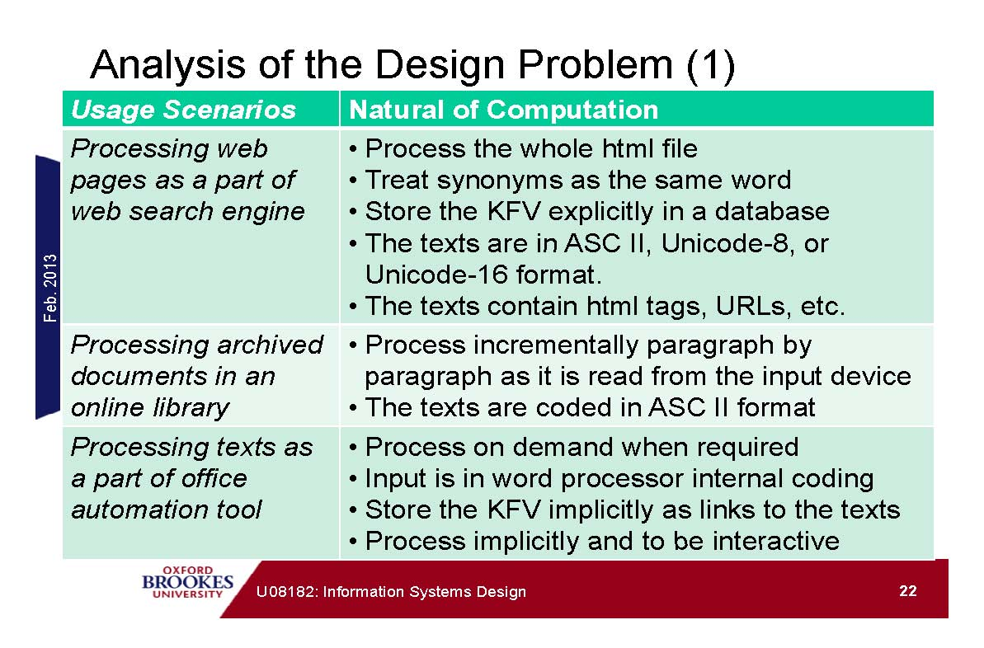
Example: Extraction of Keyword Frequency Vector

Slide 28
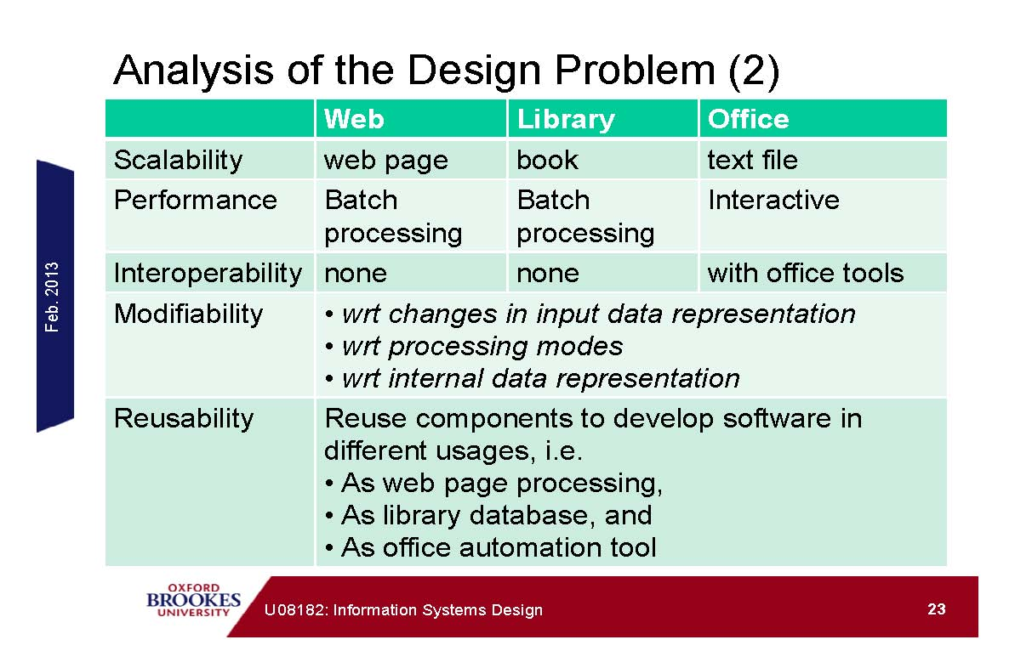
Quality Concerns

Slide 29
Definition of Scenarios
Scenario 1: Extract keyword frequency vector incrementally as a paragraph is read from the input device;
Scenario 2: Extract keyword frequency vector on the whole text file after they are read;
Scenario 3: Extract keyword frequency vector on demand when the keyword frequency vector is required;
Scenario 4: Change the data representation of text;
Scenario 5: Change the data representation of words;
Scenario 6: Change the data representation of characters;
Scenario 7: Change the data representation of keyword frequency vector;
Scenario 8: Treat synonyms as the same word in the extraction of keyword frequency vectors
Scenario 9: Delete and insert words from the original text.
Notes:
Derived from the requirement spec

Slide 30
Classify Scenarios
Direct scenario
Anticipated use in the scenario requires no modification to the system for the scenario to be performed.
This would usually be determined by demonstrating how the existing architecture would behave in performing the scenario (rather like a walk-through simulation of the system conducted in terms of the architectural constructs).
Indirect Scenario
There must be some change to the system that we could represent architecturally for the scenario to be performed
This change could be:
a change to how one or more components perform an assigned activity
the addition of a component to perform some activity
the addition of a connection between existing components
a combination of these factors
Notes:
Direct - Directly supports, no need to change
Indirect - Change needed, could also mean additional components needed

Slide 31
Design 1: Shared data storage
Master Control
Input
Delete small words
Reduce word to original form
Statistics of frequency
Sort according to frequency
Output
List of small words
Dictionary
Text
Keyword frequency vector

Slide 32
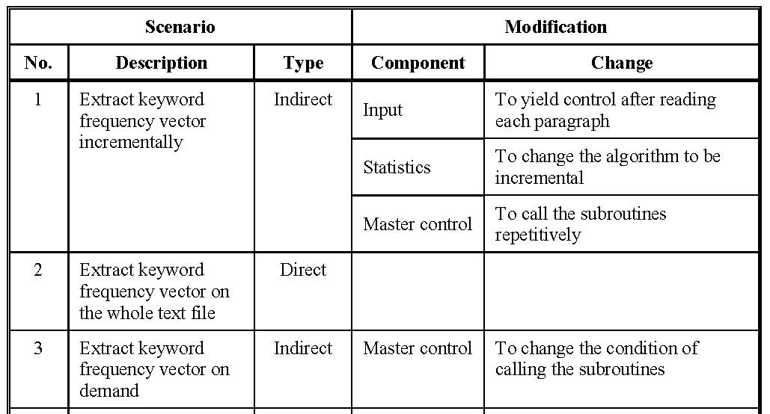
Perform Scenario Evaluations: Part 1
Notes:
If type is indirect it means the current design cannot fore fill the scenario.
This table needs to be produced for each design.
DIRECT MEANS NO CHANGE

Slide 33
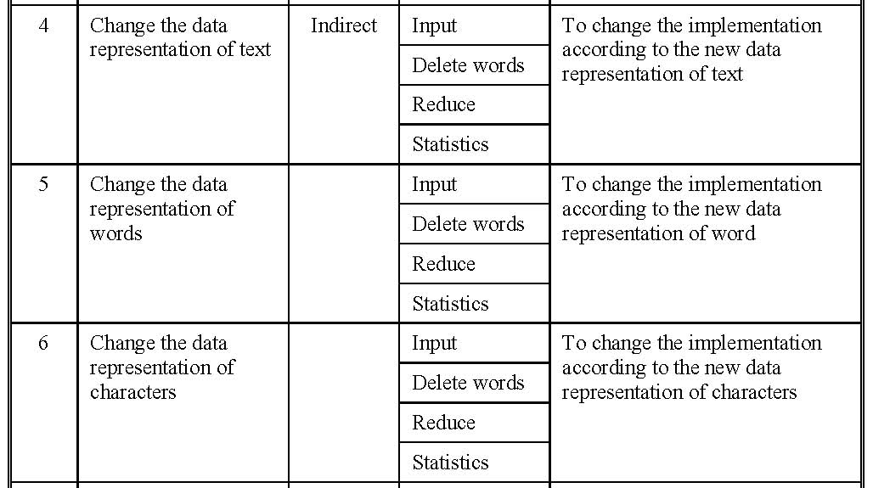
Part 2:

Slide 34
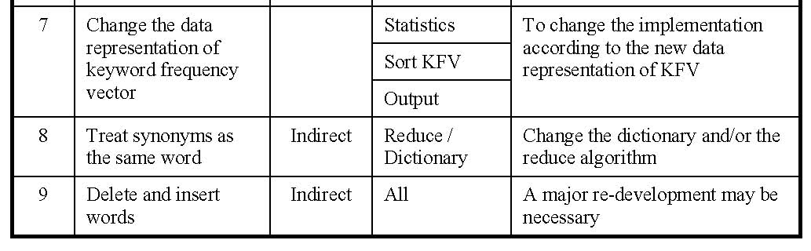
Part 3:

Slide 35
Scenario Interaction
When two or more indirect scenarios require changes to a single component of a system, they are said to interact in that component.
Scenario interaction exposes the allocation of functionality to the product’s design.
The interaction of semantically unrelated scenarios ⇒ system modules are computing semantically unrelated functions.
Areas of high scenario interaction ⇒ potential poor separation of concerns in a system component.
Area of scenario interaction indicate where the designer should focus subsequent attention.
The amount of scenario interaction is related to metrics such as structural complexity, coupling, and cohesion.
High interaction among fundamentally different scenarios ⇒ low cohesion and high structural complexity.
High interaction among fundamentally similar scenarios ⇒ high cohesion.
Notes:
Scenarios overlap in the modification. Multiple scenarios need to modify the same component.
High overlaps suggest poor separation, should split the code into smaller chunks.
Just need to pay attention to areas of interaction, indicates complexity of components

Slide 36
Reveal Scenario Interaction
Shared data store architecture
Master Control
1, 3, 9
1,4,5,6,9
1, 4, 5, 6, 9
Input
Delete small words
1, 4, 5, 6, 8, 9
1, 4, 5, 6, 7, 9
Reduce word to original form
Statistics of frequency
7, 9
Sort according to frequency
Output
7, 9
List of small words
Dictionary
8
Text
Keyword frequency vector
Notes:
Use this diagram to show the interactions and overlap

Slide 37
Evaluation of abstract data type architecture
1, 3, 9
Master Control
1
Output
Input
7
4, 6, 9
4, 6
4, 6
7
7
7
Is KFV empty?
Setup
Take Word
Is text empty?
Initialise
Add Word
Take KWF
Text
Keyword Frequency Vector
List of small words
Is small word
5
Dictionary
Reduce
5,8

Slide 38
Evaluation of implicit invocation architecture
Master Control
Extract
Input
Output
7
4, 6
4, 6
4, 6
4, 6
7
7
7
Insert
Delete
Take Word
Is text empty?
Add Word
Delete Word
Take KWF
Is KFV empty?
Text
Keyword Frequency Vector
List of small words
Is small word
5
Dictionary
Reduce
5, 8

Slide 39
Evaluation of pipe-and-filter architecture
Stream of characters
Stream of words
Stream of words without small words
Stream of words in original forms
9
Input
9
Reduce word to original form
9
Delete small words
Sort words alphabetically
3, 9
9
9
7,9
Statistics of frequency
Sort according to frequency
Output
Stream of words in the alphabetic order
Stream of word-frequency pairs
Keyword frequency vector
KFV in required output format

Slide 40
Overall Evaluation
The steps
Assign weight to each scenario
The weight represent the importance of the scenario
The purpose of assigning weights is to resolve conflict situations
Assigning weights is a subjective process
The analyst has the freedom of chose the weights
Measure the architecture on each scenario
Such measurement is usually coarse grained
Measurement should be based on the analysis of the architecture on each scenario
The analyst has the freedom to chose the metric
The metric should be used consistently for all candidates
Calculate the overall evaluation
The evaluation is the weighted sum of the measurements on the scenarios
Notes:
Weight represents a combination of importance and frequency of occurrence.
Measure the architecture - How hard is it to apply the modifications?
Likelyhood * effort
Eg 20% * 2 man days See next slide

Slide 41
Evaluation of KFV Architectures
Scenarios
Architectures
No.
Weight
Shared data
Abstract data type
Implicit invocation
Pipe-and-filter
1
20
5/7
2/12
0
0
2
5
0
0
0
0
3
15
1/7
1/12
0
1/7
4
5
4/7
3/12
4/14
2/7
5
5
4/7
2/12
2/14
2/7
6
5
4/7
3/12
4/14
2/7
7
10
3/7
4/12
4/14
1/7
8
15
1/7
1/12
1/14
1/7
9
20
7/7
4/12
0
7/7
Overall
51.43
19.15
7.49
30.00
Notes:
Effort is in how many components to be changed, not man days.
Eg
Number 1
20 * (5/7)
Make weights add up to 100
Overall is the amount of code that needs to be changed.

Slide 42
Dependencies among SAAM analysis activities
Scenario development
Individual evaluation of indirect scenarios
Assessment of scenario interaction
Classification of scenarios
Overall evaluation
Architecture description

Slide 43
Further Readings
[1] Zhu, H., Software Design methodology. Chapter 9, pp223-248; Chapter 10, pp249-276.
[2] Bass, L., Clements, P. and Kazman, R., Software Architecture in Practice, Addison Wesley, 1998. Chapter 9: Analyzing Development Qualities at the Architectural Level: The Software Architecture Analysis Method, pp189~1220
[3] Clements, P., Kazman, R. and Klien, M., Evaluating Software Architectures: Methods and Case Studies, Addison Wesley, 2002.

